Slide 1
TEAM ID: 502 TEAM MEMBERS: Anurag Naresh Maldhure Mahima Khushal Dhurve Akash Vinayak Zalke Rutika Pramod Warade
1

Slide 2
ON LINE INSTALLATION OF DRIPPER WITH ROBOTIC ARM ON ROVER
2

Slide 3
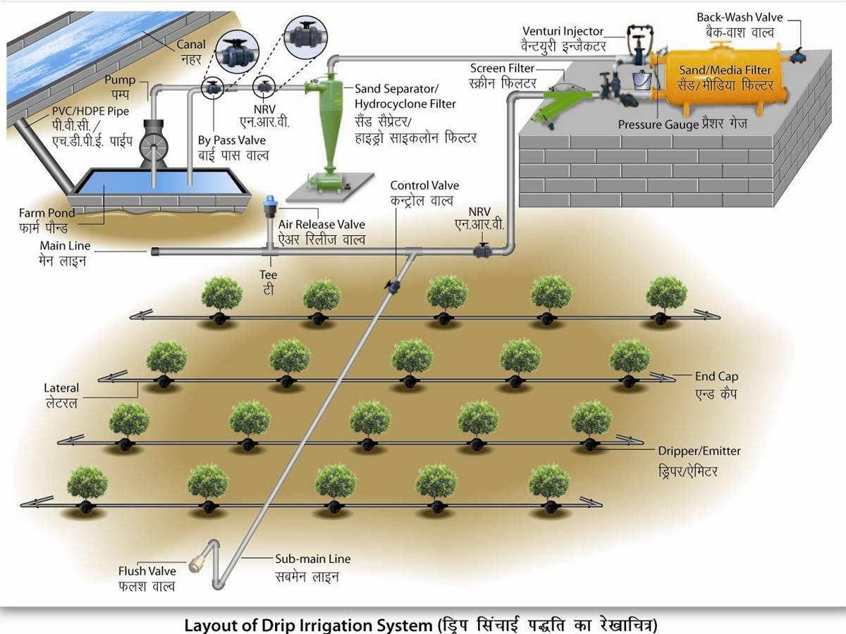
INTRODUCTION
Drip irrigation is one of the most effective methods to provide water/fertilizers and its nutrients directly to plants. This method delivers water and its nutrients directly to the roots in the appropriate amount when required. Water is delivered across the field in pipes called dripper lines featuring smaller units which are called drippers. Dripper specifically emits drops containing water. This method also reduces the chances of leaching. This method gives a maximum yield with lessening of weed growing and maximum utilization of the fertilizers. Also this method can be implemented on both regular and irregular species of land if properly installed.
Drip irrigation is known to be the most efficient irrigation methods with 95-100% water use efficiency. This is compared to sprinkler systems that have 80-85% water use efficiency or flood and furrow that are 60-70% efficient. Efficiency is related to the effectiveness of the system on crop performance and eventually on yield and profitability of the farmer.

Slide 4
PROBLEM EXPLANATION
Drip system installation is a long process which punching the holes in the dripper tubes, screwing the vacuum break, laying out the tube, installing if the ground stakes, laying tube around the shrubs and trees, positioning sprayers for ground overclose off the tubing’s end , cover the tubing with mulch . While performing these tasks sometimes the farmer may hurt himself while punching the holes in the tubes. Also for making so many punches the farmers have to stand and sit again and again which may result in the back and knee pain for the farmer. Therefore , we thought of creating a rover which may be used by the farmer to install a dripper system.

Slide 5
Why do farmers prefer drip irrigation?
Drip Irrigation not only delivers greater ROI compared to other of irrigation methods, it also gives farmers an efficient and simple way to operate their farms.
Higher consistent quality yields
Huge water savings: no evaporation, no run off, no waste
100% land utilization - drip irrigates uniformly in any topography and soil type
Energy savings: drip irrigation works on low pressure
Efficient use of fertilizer and crop protection, with no leaching
Less dependency on weather, greater stability and lower risks

Slide 6
PROSPOSED SOLUTION
On line Installation of dripper with robotic arm mounted on rover. The rover will be equipped with the cameras and with help of Computer Vision we will complete stages of installation of drip irrigation system.

Slide 7
MODULES TO DESIGN
Input images
Processing image
Crowd count

Slide 8
BENEFITED MULTITUDE
Less manpower for installation of drip irrigation.

Slide 9
TECHNOLOGIES REQUIRED
Hardware Requirements: Rover, Line installation mechanism, camera, drill and tap installation mechanism,
Software Requirements: Solidworks, CATIA, Python/Matlab, MongoDB/Flask for server creation,

Slide 10
THANK YOU!
12

